Slide 1
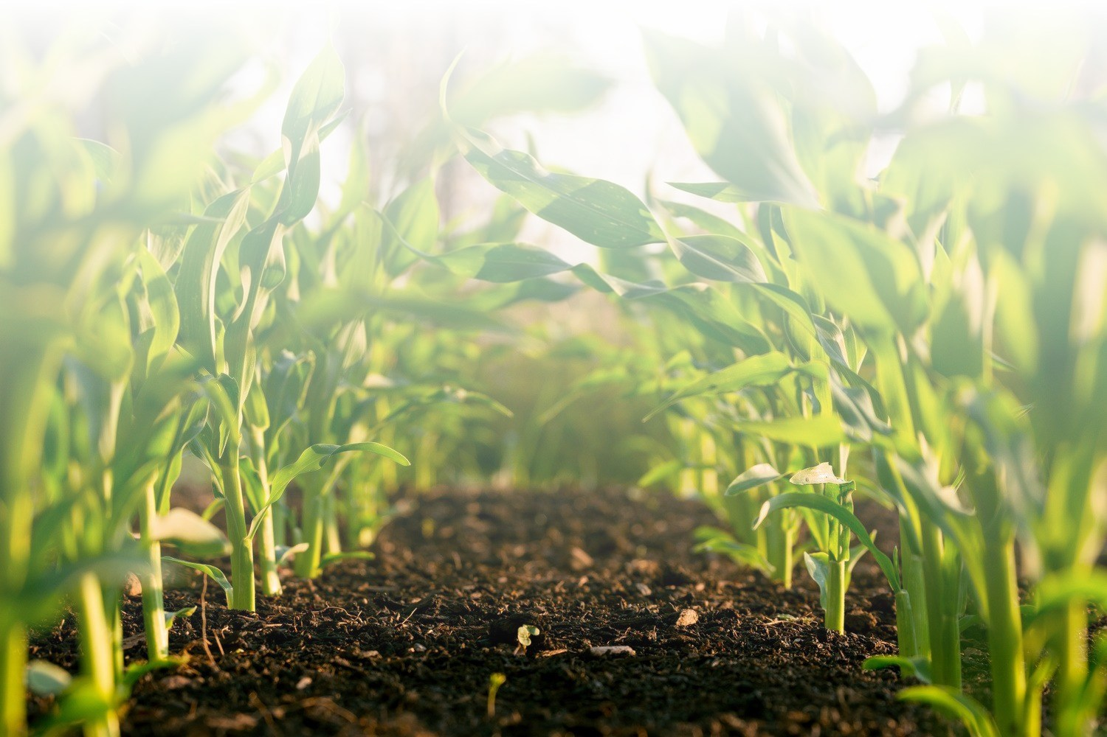
MiR3.lu
bringing waste to life.

Slide 2
MiR3.lu
bringing waste to life.
What we do…

Slide 3
Fresh locally grown Luxembourgish tomatoes for Christmas ?
Yes please.
Page 3

Slide 4
Luxembourg is heavily dependent on the importation of vegetables.
97% is imported.
Page 4

Slide 5
That changes now.
Page 5

Slide 6
Replacing imports.
Creating local jobs.
Avoiding emissions.
Page 6

Slide 7
Profitable.
Page 7

Slide 8
Industrial symbiosis
Industrial symbiosis (IS) is a system approach that connects different industrial stakeholders to leverage underutilised resources in a more integrated and sustainable way.
Page 8

Slide 9
Using industrial waste heat.
Using 100% rainwater.
Nearly no pesticides nor fertilizers.
In an controlled environment.
Page 9

Slide 10
We produce ~1.500 Ton vegetables, in Luxembourg’s first high-tech greenhouse.
This represents 50% of the Luxembourgish annual demand for fresh tomatoes.
Page 10

Slide 11
Responsibly produced using waste heat from a datacenter.
And providing cold back to the datacenter.
Using 100% rainwater.
Page 11

Slide 12
Bringing waste to life.
Page 12

Slide 13


Slide 14
MiR3.lu - Mission
Bringing waste to life. Turning waste streams into value.
Responsible, Renewable and Recyclable. Profitable.
We develop projects that capture industrial waste streams and we valorise these.
We bring finance, operations and government together to facilitate Industrial Symbiosis. Our projects deliver needed outputs and jobs, sustainable and profitable.
MiR3.lu
Page 14

Slide 15
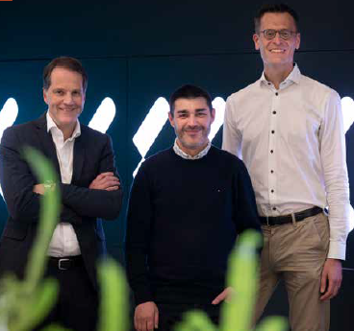
Who are we ?
Ralf Bartz, Nuno Rodrigues & Roel Hoogveld

Slide 16
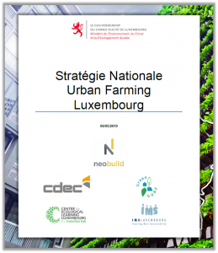
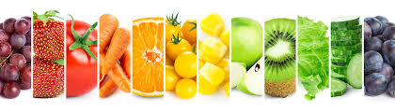
Vegetable production in Luxembourg
3% autarky in Luxembourg
for fruits and vegetables
76% consider origin
as the most
important criteria
to purchase
50% of global tomato production originates from China
Page 16
Notes:
THE NATIONAL URBAN FARMING STRATEGYThe Ministry of the Environment, Climate and Sustainable Development, NEOBUILD and the Council for the Economic Development of Construction (CDEC) presented the national strategy "Urban Farming Luxembourg” on 23 May 2019.
URBAN FARMING AT THE HEART OF SUSTAINABLE DEVELOPMENT
On a social and societal level:
urban farming can be a multidimensional lever for creating social links, bringing spaces back to life, serving as a training ground, promoting reintegration and improving the well-being of citizens.
On the environmental level:
Urban farming also fulfils many ecological functions: regulation of microclimates and the overall climate of the city; improving the percolation of rain and storm water into the soil and slowing down its flow, thus preventing the risk of flooding; thermal insulation of buildings thanks to green walls and roofs; air purification; preservation of biodiversity; etc.
On the economic level:
The economic effects are felt on a local scale, with an economy stimulated by new activities, by the development of short circuits, by the creation of value because previously unexploited surfaces are transformed to produce quality food, by a more endogenous economy where the money stays longer in the local circuit

Slide 17




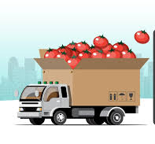
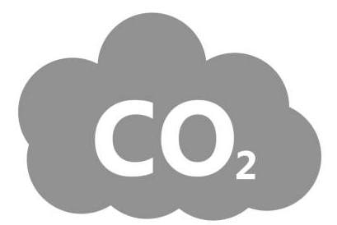
Our concept
We want to
valorise waste heat of a datacenter.
supply the waste heat to the first high-tech & largescale greenhouse in Luxembourg.
Today, only 3% of vegetables and fruits consumed in Luxembourg, are locally produced.
With this project, we are facilitating a sustainable and profitable local production and value chain.
Heat
100%
Ex: Tomatoes
~50% of the fresh
tomato market
for Luxembourg
~1.500 tons/year =
~375 trucks/year
save
2.100
tons/year
Vegetables
Pilot project
Datacenter Windhof
Cold
vs a gas-heated greenhouse
30.000 m²
Greenhouse

Slide 18

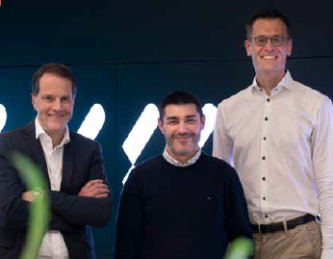
These are the update meetings with the 3 ministries & Luxinnovation
Timeline
Pilot project interministriel cooperation
Ministry of Agriculture, Economy, Environment, under coordination of Luxinnovation : 1st meeting
1st mtg & support Ministry of Agriculture
Verified client interest
Sign contract partner
Determination partner
Start construction
Opening
RFP : offers of partners presented to Luxinnovation and ministries
KICK-OFF
Ensure look & feel of independant partner selection - & autorisation process
doc. collection by Schroeder & Ass.
Idea validation
Define concept
Check client interest
Definition CDC for RFP
Contractualisation/APS/APD/
Etudes détaillés/Construction
On hold
Business case, financing, candidates, lobbying, RFP
SOU
Pre-authorisation process
4/2021
1/2023
5/2023
12/2024
1/2026
8/2026
TODAY
Greenhouses were not permitted in Luxembourg until 2024.
Market review (supermarkets, farmers)
Validate business case : support CoConcept
technical validation Jean Schmitt Engineering
Meeting with ministers Fayot (Economy), Haagen, (Agriculture) & Joelle Welfring (Environment)
9/2023
OK & Go
The initiators : Ralf, Nuno, Roel

Slide 19
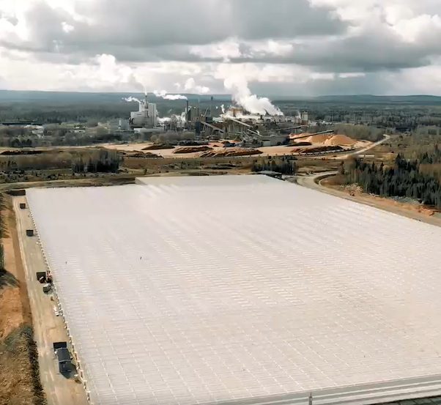
MiR3.lu concept
Use industrial waste heat to heat the first industrial greenhouse of Luxembourg and produce locally grown vegetable all year long.
Page 19

Slide 20
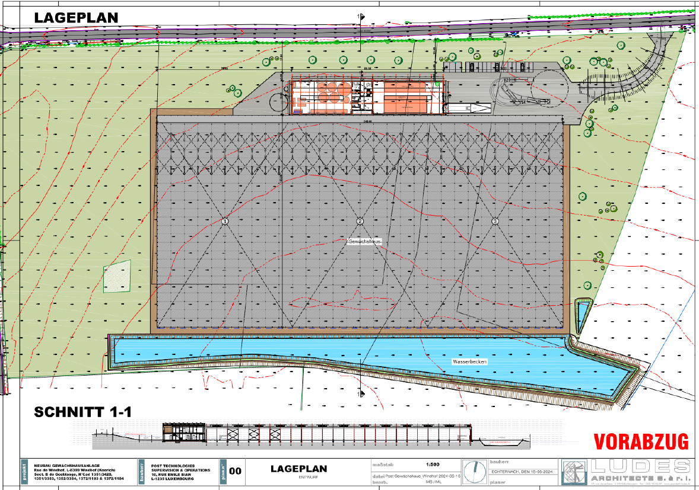
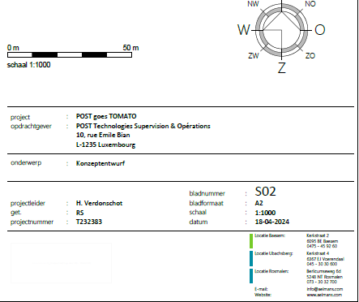
Page 20

Slide 21
Page 21

Slide 22
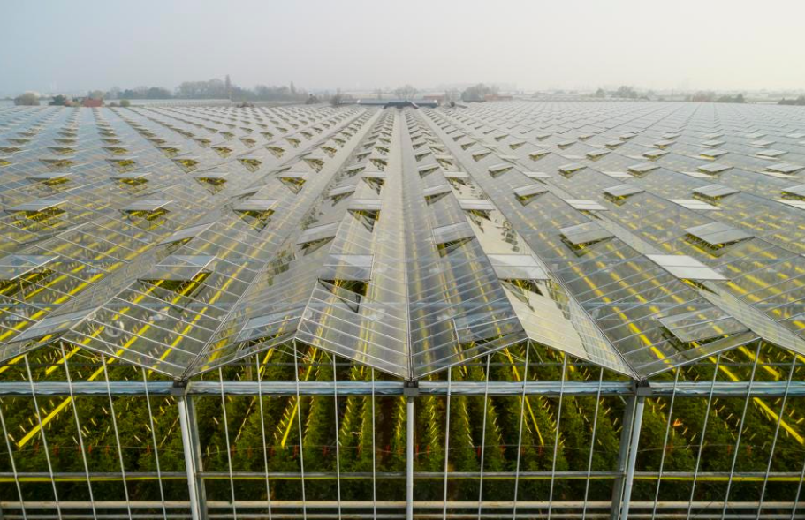
Reference images
Page 22

Slide 23
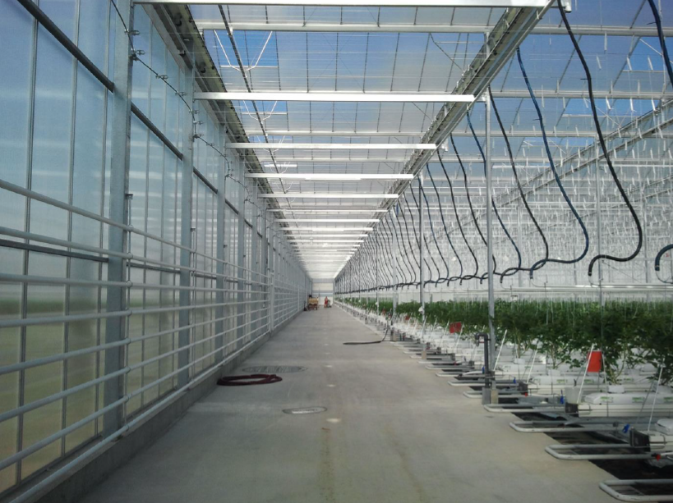
Reference images
Page 23

Slide 24
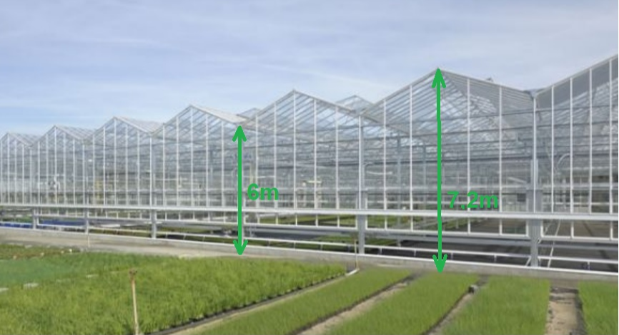
Reference images
Page 24

Slide 25

Why greenhouses make sense ?
Increases Luxembourgish autarky (3% is locally grown). A greenhouse produces more resource effective.
Responsibly produced vegetables using waste heat from a datacenter. And providing cold back to the datacenter. Heating costs represent 25% of the Opex of a greenhouse.
The pilot project in Koerich is covered by 100% rainwater (water reservoir). A greenhouse consumes 90% less water vs open field cultivation. Protection of natural water and soil due to closed-loop production.
A greenhouse hardly requires any pesticides as it is a closed environment.
Greenhouses were not authorized in LU, for example has 10.000 hectares high-tech greenhouses.
We managed to get a project in place in a green zone, supported by the ministry of environment.
Labor : creation of all year jobs (not seasonable labor), ~25 FTE’s. And integrative labor is possible.
Increased local value chain using the advantages of regionality for more quality and durability and less transportation, ecologic production according to local standards and labels.
Page 25
Notes:
Since 2021 we explored the market to produce vegetables using Data Center waste-heat.
Below potential partners were surprised that POST can be the enabler to finally produce vegetables economically profitable in Luxembourg with Luxembourgish partners in a sustainable manner.
This market enthusiasm made us believe this project can be realized and have a positive impact to Luxembourg.

Slide 26
MiR3.lu
Bringing waste to life.
Turning waste streams into value.
Page 26

Slide 27
Thank you.

Slide 28
Backup slides

Slide 29
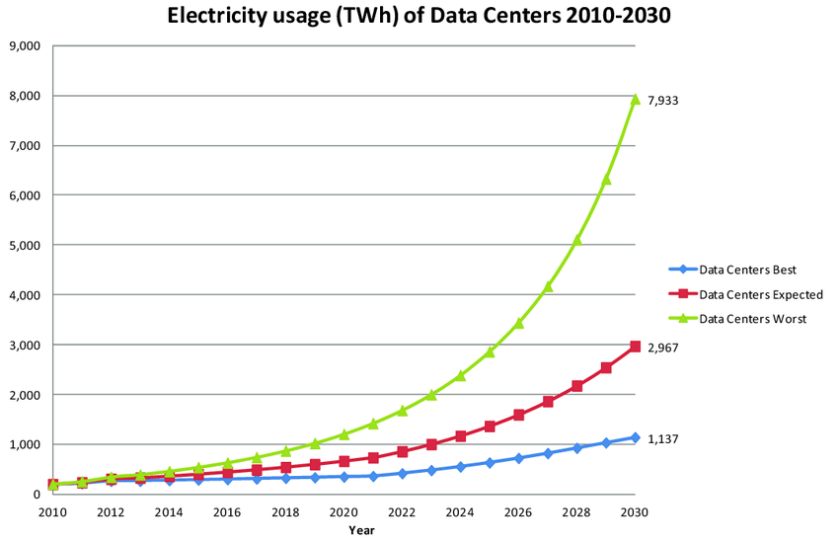
Datacenter energy consumption today…..and tomorrow ?
DC’s today: 1% of the world’s
electricity demand.
In 2030: 2%
i.e. Artificial Intelligence
Luxembourg intends to become The country for safe data storage in the EU (Luc Frieden)
Page 29

Slide 30
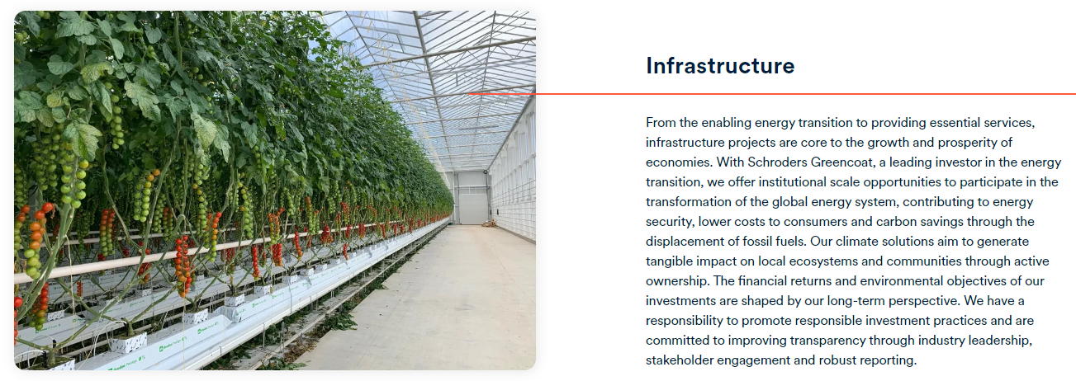
Schroders Capital Homepage
Greencoat Capital

Slide 31
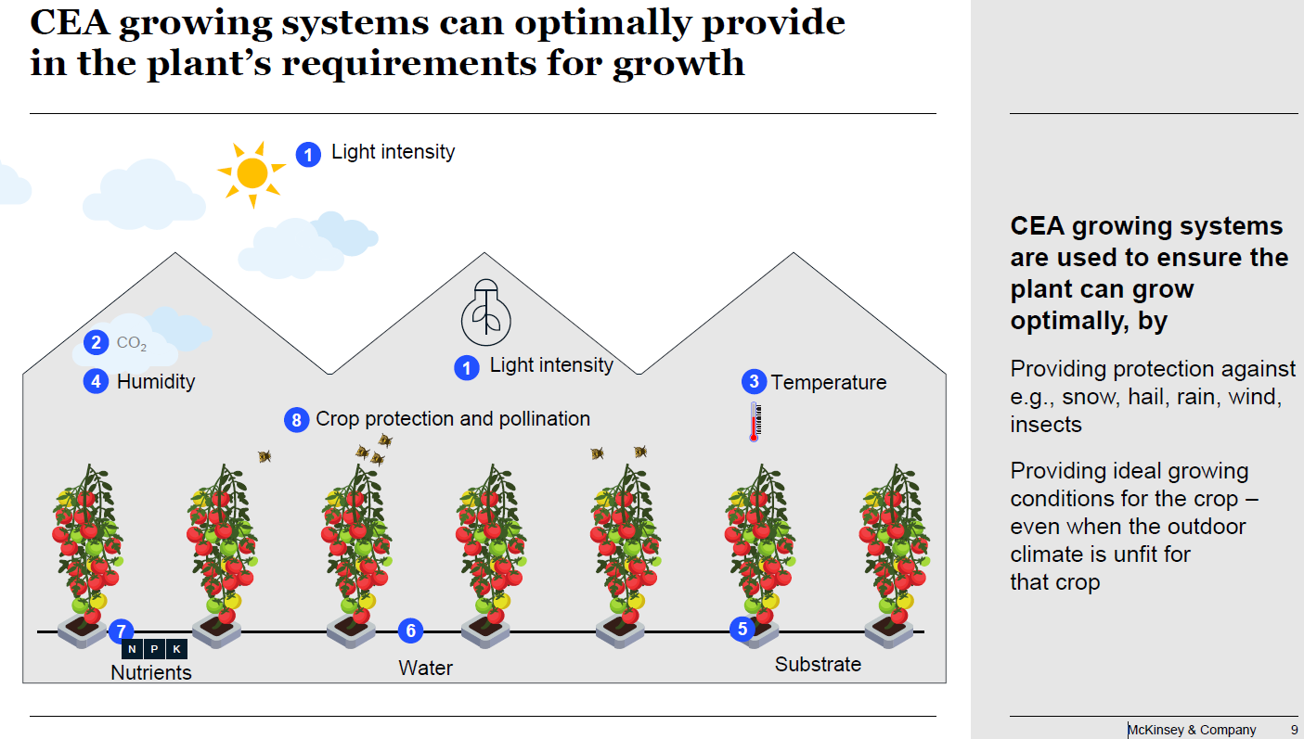

Slide 32
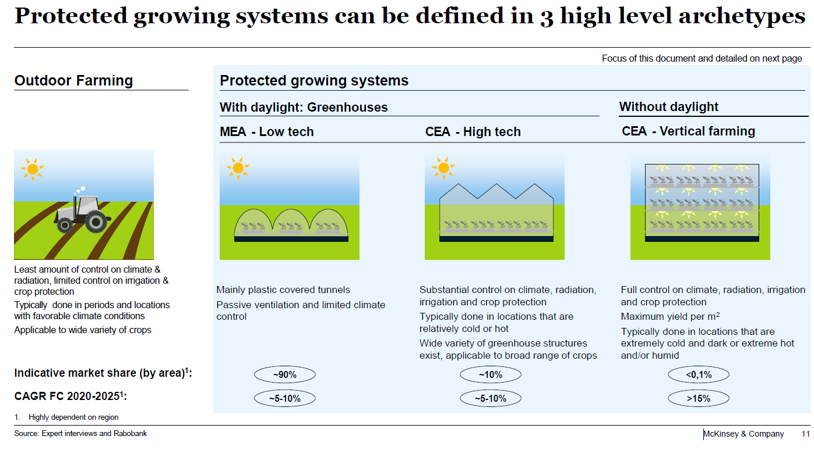

Slide 33

Simple timeline
TODAY
Start
June 2026
July 2021
Feb 2024
Dec 2024
Dec 2025
Concept Validation / Feasibility assessment / Establish the project
Analysis &
Pre-authorisation
Selecting partners
Final authorisations
& Build plans
Construction
Production

Slide 34
